Slide 1

Potato Chip Mailing Contest
Group #9
Roy Ernster, Yong Hyun Kim, & Harout Tahanian

Slide 2
Objective/Requirements
Build a box that is able to hold a potato chip, be mailed, and come back to the class, without having the chip break.

Slide 3
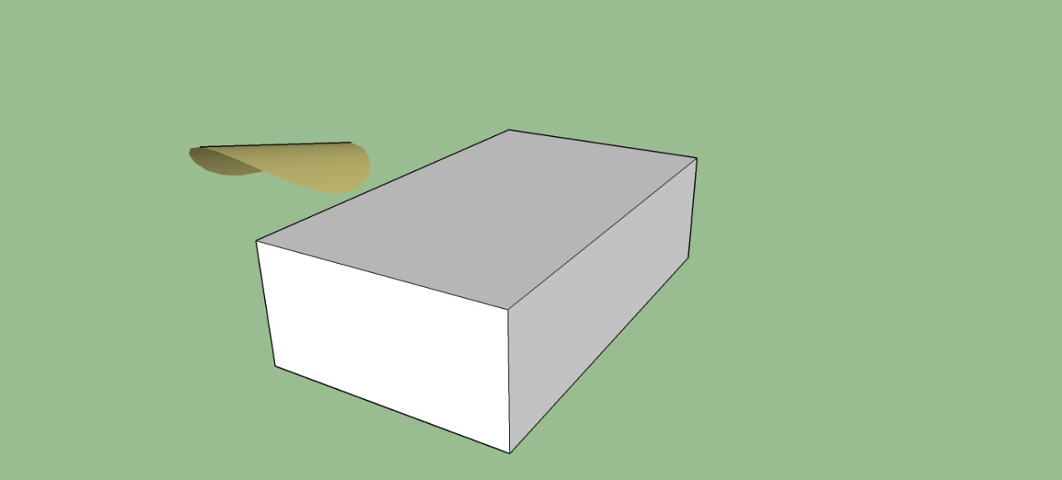
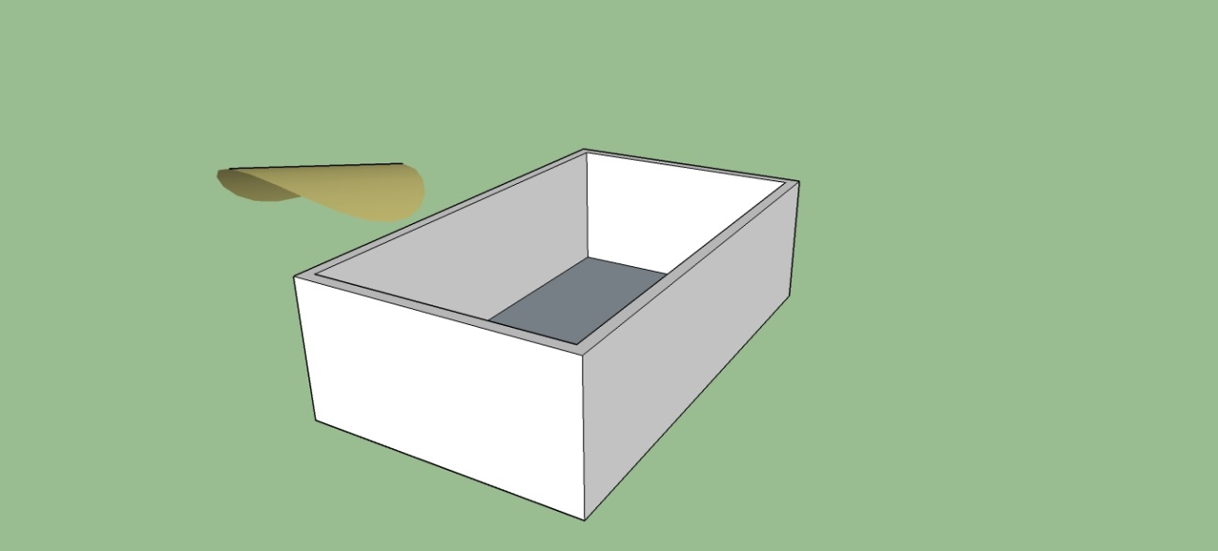
Design
Length: 5 Inches
Width: 3 Inches
Height: 1 ½ Inches

Slide 4
Predicted Score with Explanation
By using the formula provided by Dr. Neat, we were able to make a prediction for our end score. We hope and expect to get an 8.5 or at least close to this score.

Slide 5

Parts List
Cardboard
Cotton Balls
Tape
Wood Glue

Slide 6
Photo of Mailed Container

Slide 7
Data

Slide 8
Lessons Learned

